Slide 1
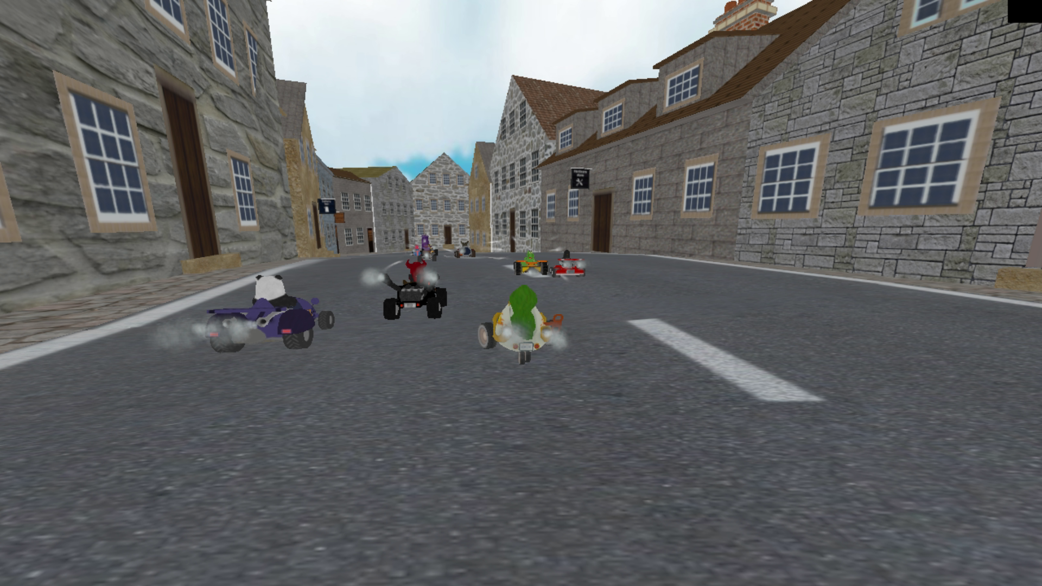
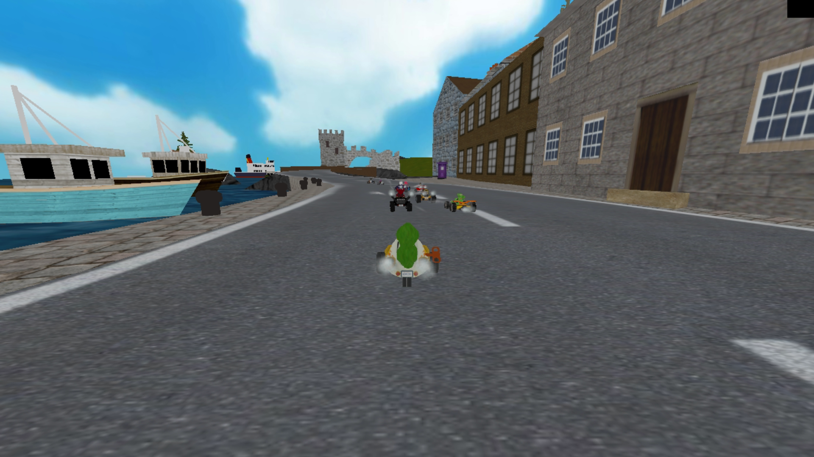
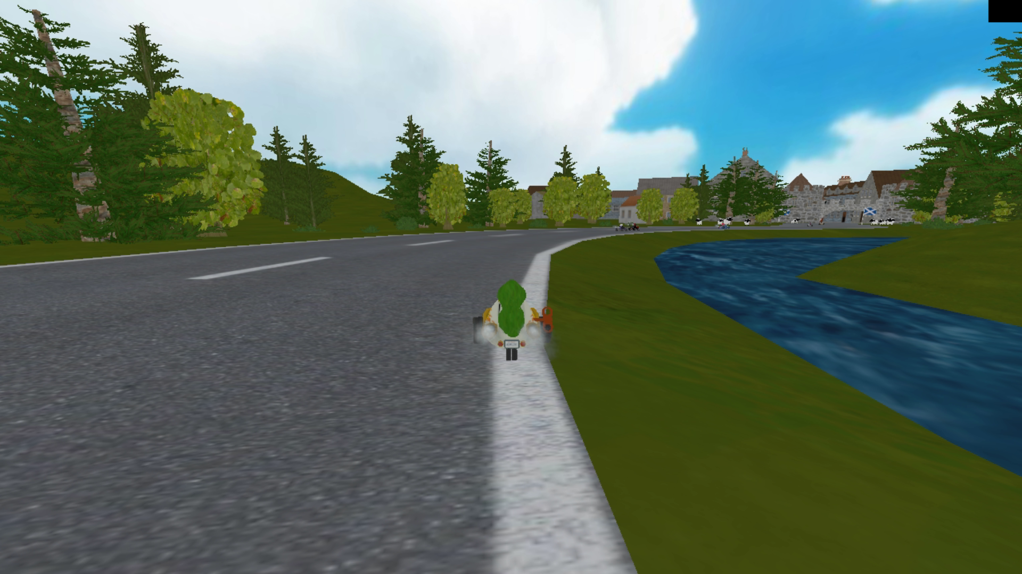
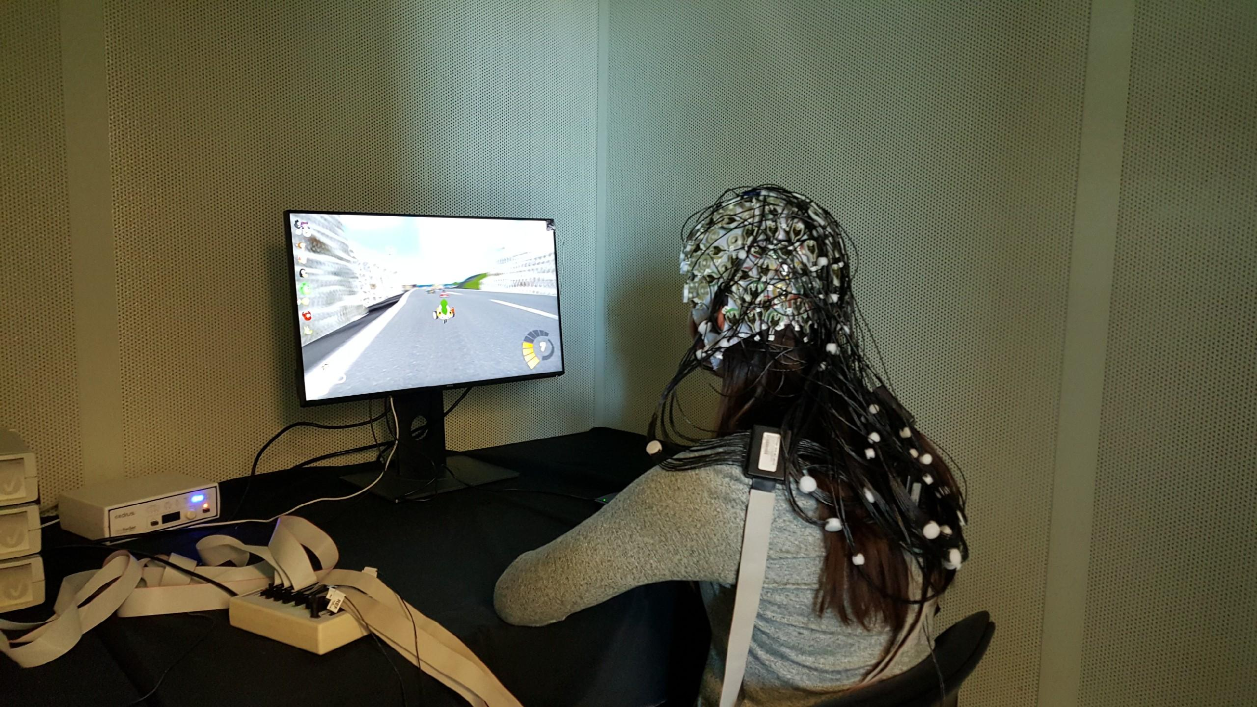
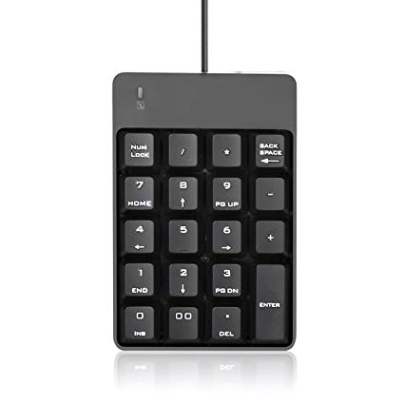
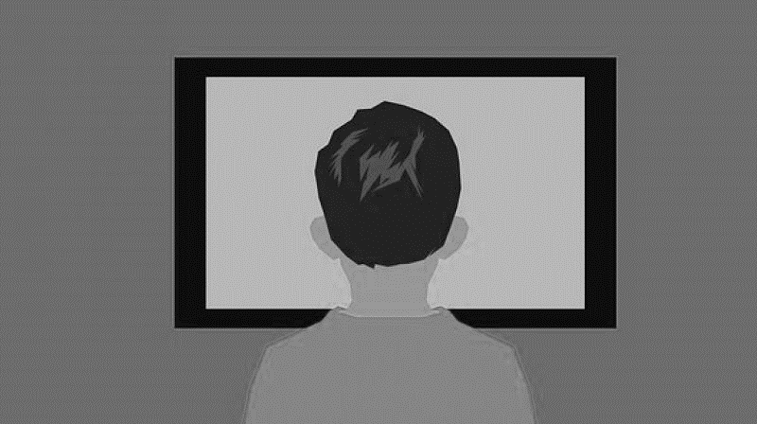

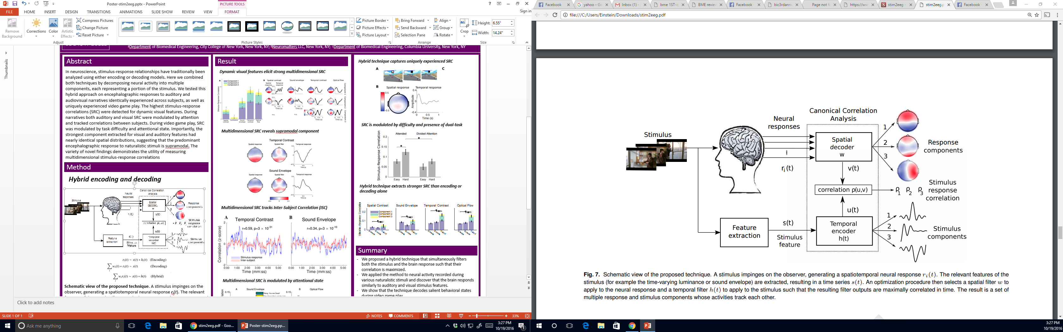
A
B
Play
Watch
Imagined Brain Controller
C

Slide 2

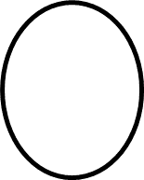

Slide 3

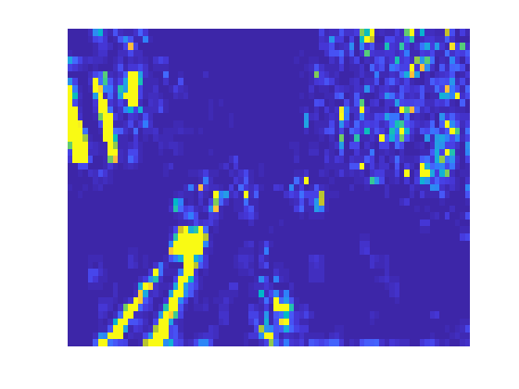
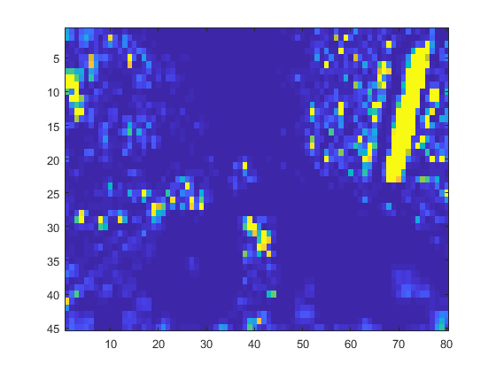
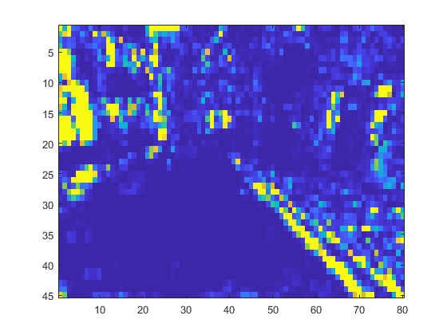

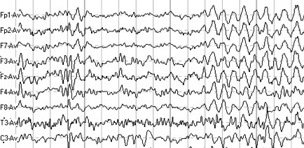


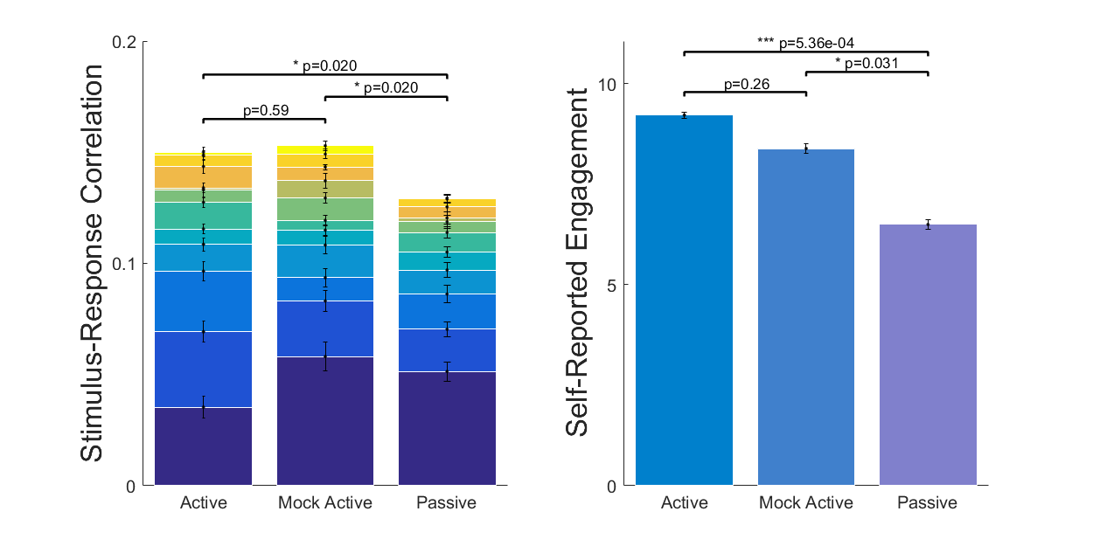
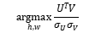
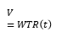
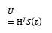
Temporal Response Filter (H)
S(t)
h₁
h₂
h₃
.
.
h_{k}
Record Video
Optic Flow
Canonical Correlation Analysis
Record EEG
$$U=HTS\left(t\right)$$
$$V=WTR\left(t\right)$$
Spatial Filter (W)
$$p=Corr{(U\text{,}V\text{)} }$$
R(t)
$$\underset{h,w}{argmax}{\frac{UTV}{{σ_{U}σ}_{V}}}$$
w₁
w₂
w₃
.
.
w_{k}
Keyboard Play
Mock BCI Play
(deception)
Watch
Processed
EEG
T ~ 620s
Active
Mock Active
Passive
Learn Maximally
Correlated
Filters
Stimulus Response Correlation
Experiment
Feature Extraction

Slide 4
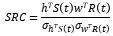
$$SRC=\frac{hTS\left(t\right)wTR\left(t\right)}{{σ_{hTS\left(t\right)}σ}_{wTR\left(t\right)}}$$

Slide 5


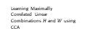
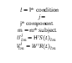
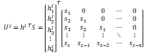
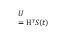
Optic Flow S(t)
Temporal Filtering (H)
$${U^{j}=h^{j T}S=\left[\begin{matrix}h_{1}^{j} \\ h_{2}^{j} \\ h_{3}^{j} \\ ⋮ \\ h_{τ}^{j}\end{matrix}\right]}^{T}\left[\begin{matrix}s_{1} & 0 & 0 & ⋯ & 0 \\ s_{2} & s_{1} & 0 & ⋯ & 0 \\ s_{3} & s_{2} & s_{1} & ⋯ & 0 \\ ⋮ & ⋮ & ⋮ & ⋱ & ⋮ \\ s_{t} & s_{t−1} & s_{t−2} & ⋯ & s_{t−τ}\end{matrix}\right]$$
$$s_{t}^{ }$$
$$s_{t−1}^{ }$$
$$U_{ }^{1}$$
$$s_{t−2}^{ }$$
$$U_{ }^{2}$$
Modeling Temporal Response
$$s_{t−3}^{ }$$
$$U_{ }^{3}$$
$$U=HTS\left(t\right)$$
Record video
$$s_{t−4}^{ }$$
$$⋮$$
$$V=WTR\left(t\right)$$
Extract Video Feature
$$⋮$$
$$U_{ }^{K}$$
$$\left(H, W\right)=\underset{h,w}{argmax}{\frac{UTV}{{σ_{U}σ}_{V}}}$$
EEG R(t)
$$s_{t−τ}^{ }$$
Spatial Filtering (W)
Learning Maximally Correlated Linear Combinations $H$ and $W$ using CCA
Keyboard
Sham BCI
Watch
$$r_{1}^{ }$$
$$V^{j}=w^{j T}R$$
Record EEG
$$r_{2}^{ }$$
$$V_{ }^{1}$$
$$r_{3}^{ }$$
$$V_{ }^{2}$$
$l=lth condition$
$j=jth component$
m$=mth subject$
$$U_{lm}^{j}=HT{S(t)}_{lm}^{ }$$
$$V_{lm}^{j}=WT{R(t)}_{lm}^{ }$$
$$r_{4}^{ }$$
$$V_{ }^{3}$$
$$r_{5}^{ }$$
$$⋮$$
$$p_{lm}^{j}=corr(U_{lm}^{j},V_{lm}^{j})$$
Active
Sham Active
Passive
$$⋮$$
$$V_{ }^{K}$$
Stimulus Response Correlation
$$r_{D}^{ }$$
Experiment
Data
Analysis

Slide 6
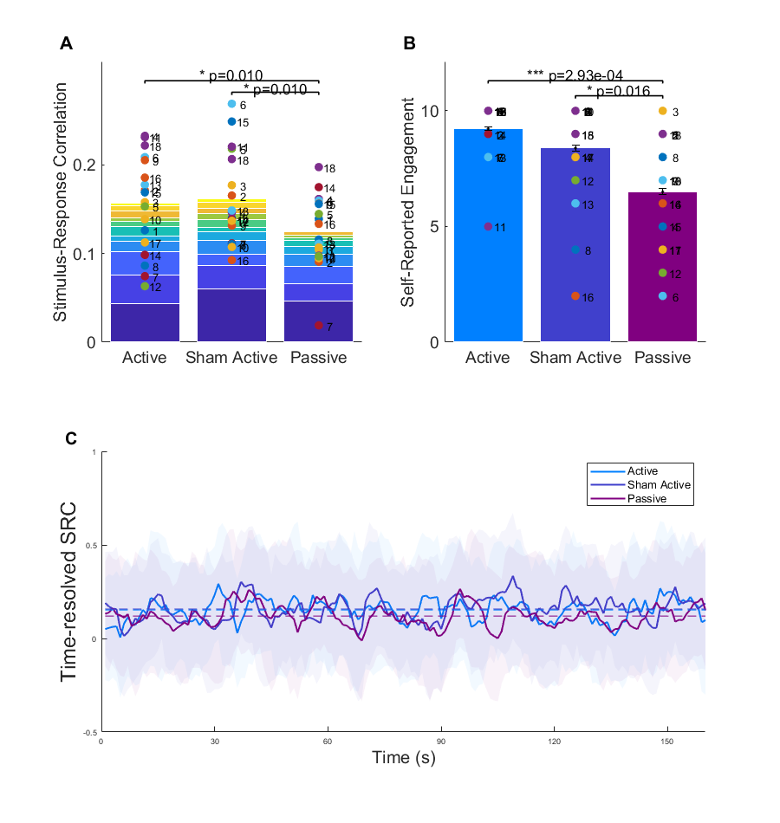

Slide 7
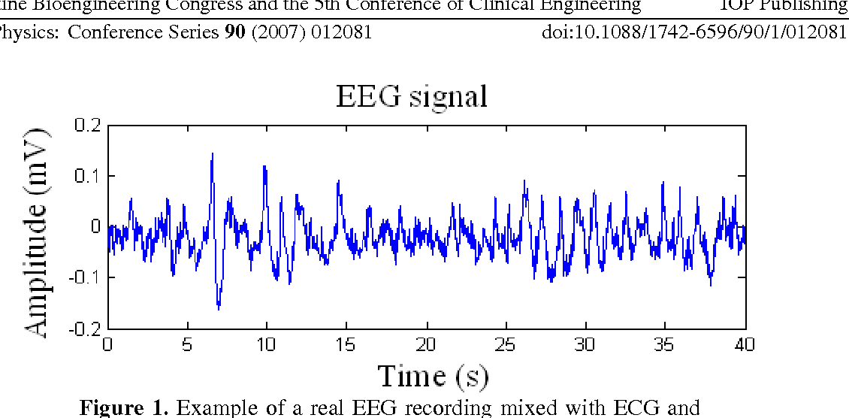

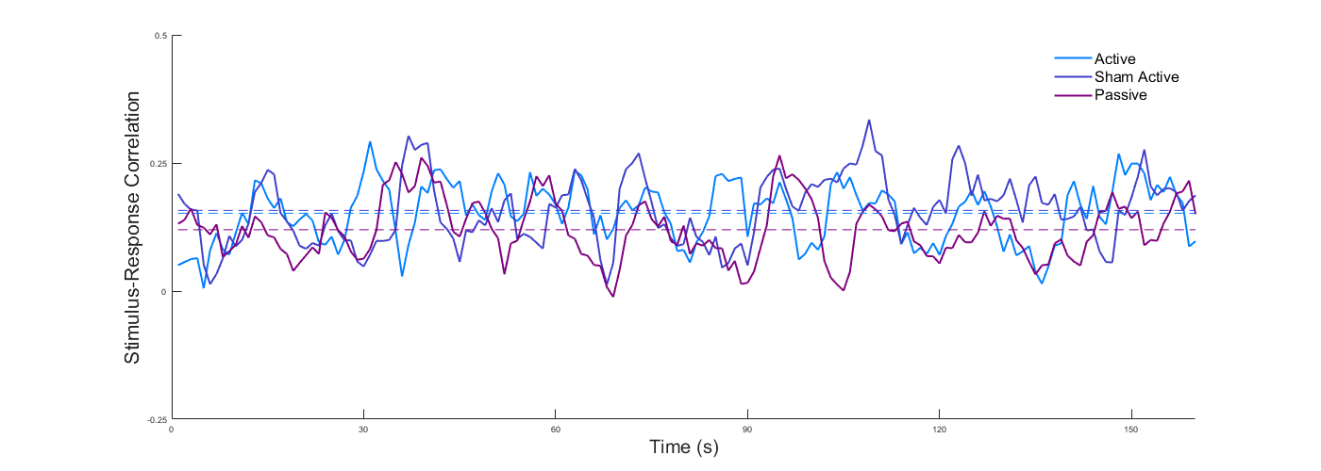
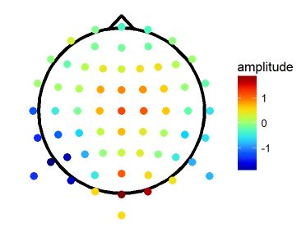


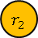

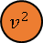

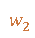
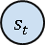
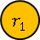
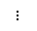
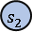

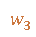
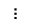

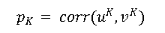
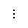
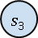
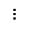
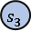
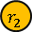
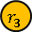
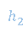


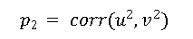



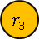
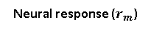
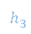


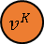
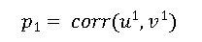
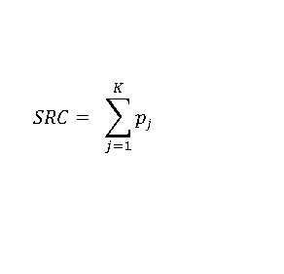
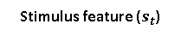


Visual Processing during Active vs Passive State
Stimulus to Response Correlation (SRC)
$$s_{1}^{ }$$
$$u_{ }^{1}$$
$$p1= corr(u_{ }^{1},v_{ }^{1})$$
$$r_{1}^{ }$$
$$s_{2}^{ }$$
$$p2 = corr(u_{ }^{2},v_{ }^{2})$$
$$v_{ }^{1}$$
$$r_{2}^{ }$$
$$u_{ }^{2}$$
$$s_{3}^{ }$$
$$⋮$$
$$v_{ }^{2}$$
$$r_{3}^{ }$$
$$u_{ }^{K}$$
$$pK = corr(u_{ }^{K},v_{ }^{K})$$
$$⋮$$
$$SRC= \sum_{j=1}^{K}{pj}$$
$$v_{ }^{K}$$
$$⋮$$
$$s_{t}^{ }$$
Hybrid encoding-decoding
$$r_{N}^{ }$$
Active
Sham Active
Passive
$$s_{1}^{ }$$
$$h_{1}^{ }$$
Neural response ($r_{m}^{ }$)
$$s_{2}^{ }$$
$$h_{2}^{ }$$
$${\hat{r}}_{m}^{ }$$
$$h_{3}^{ }$$
$$w_{1}^{ }$$
t
$$s_{3}^{ }$$
$$r_{1}^{ }$$
$$h_{τ}^{ }$$
$$w_{2}^{ }$$
$$r_{2}^{ }$$
Stimulus feature ($s_{t}^{ }$)
$$⋮$$
$$w_{3}^{ }$$
$$w_{N}^{ }$$
$$r_{3}^{ }$$
$${\hat{s}}_{t}^{ }$$
$$⋮$$
t
Encoding
Decoding
Experiment
Analysis

Slide 8


















Encoding
Stimulus Feature S(t)
$$s_{t}^{ }$$
$$u_{ }^{1}$$
$$s_{t−1}^{ }$$
$$u_{ }^{2}$$
$$s_{t−2}^{ }$$
$$⋮$$
$$⋮$$
$$u_{ }^{K}$$
$$s_{t−τ}^{ }$$
corr(u¹ ,v¹)
corr(u² ,v²)
∑
SRC
Hybrid encoding-decoding
$$⋮$$
EEG R(t)
corr(u^{k} ,v^{k})
$r_{1}^{ }$($t)$
$$v_{ }^{1}$$
$$r_{2}^{ }\text{(}t)$$
$$v_{ }^{2}$$
$$r_{3}^{ }\text{(}t)$$
$$⋮$$
Manual
Gameplay
$$⋮$$
$$v_{ }^{K}$$
Sham BCI
Passive Viewing
$$r_{4}^{ }\text{(}t)$$
Decoding

Slide 9
















A
B
C
Stimulus feature s(t)
$$s(t)$$
$$u_{1}^{ }\text{(}t)$$
$$s(t−1)$$
$$u_{2}^{ }\text{(}t)$$
$$s(t−2)$$
$$⋮$$
$$⋮$$
$$u_{K}^{ }\text{(}t)$$
S($t−τ)$
corr
corr
∑
SRC
Neural response r(t)
$r_{1}^{ }$($t)$
corr
$$v_{1}^{ }\text{(}t)$$
$$r_{2}^{ }\text{(}t)$$
$$v_{2}^{ }\text{(}t)$$
$$r_{3}^{ }\text{(}t)$$
$$⋮$$
Active
Play
Sham Play
Passive Viewing
$$⋮$$
$$v_{K}^{ }\text{(}t)$$
$$r_{D}^{ }\text{(}t)$$

